Slide 1

Debt Review Committee
Appointed by the Lynn Haven City Commission
Presented August 24, 2021

Slide 2
Overview
Introduction of the Debt Review Committee Members
The Committee’s objectives
Cursory view of meetings and topics discussed
Analysis of current and historic debt
Estimated Disaster Bond cash flow thru 9-1-25
Community Disaster Loan
Recommendations to the City Commission

Slide 3
Debt Review Committee Members
Twila Miller, Retired, Former Deputy Finance Director, City of Lynn Haven, 40-year resident
Alfred McCambry, Dean Workforce Development & Director Gulf/Franklin Campus, Gulf State College, 13-year resident
Joey Ginn, Centennial Bank Market President, 25-year resident
Brian Gray, Readjustment Counselor Therapist Bay County Vet Center, longtime resident
Frank Hall, President - Panama City Market BancorpSouth, 26-year resident
Vickie Gainer, City Manager
Kiki Roman, Deputy Finance Director

Slide 4
The Committees Objectives
Review existing debt commitments
Review historical debt trends
Meet with bond consultants
Identify potential debt reductions/restructuring
Report findings to City Commission

Slide 5
Meetings and Topics Discussed (June 18 – Aug. 24)
Each Bond/Note was individually reviewed
Detailed history of the decision to issue 2019 Disaster Recovery Bond
Overview by bond consultants to discuss bond market trends
Estimated cash flow for 2019 Disaster Recovery Bond balance
Review of hurricane insurance settlement
Review of Community Disaster Loan (CDL)
Review of American Rescue Plan
Discussion of recommendation for potential prepayments
Discussion of recommendation for potential restructuring

Slide 6
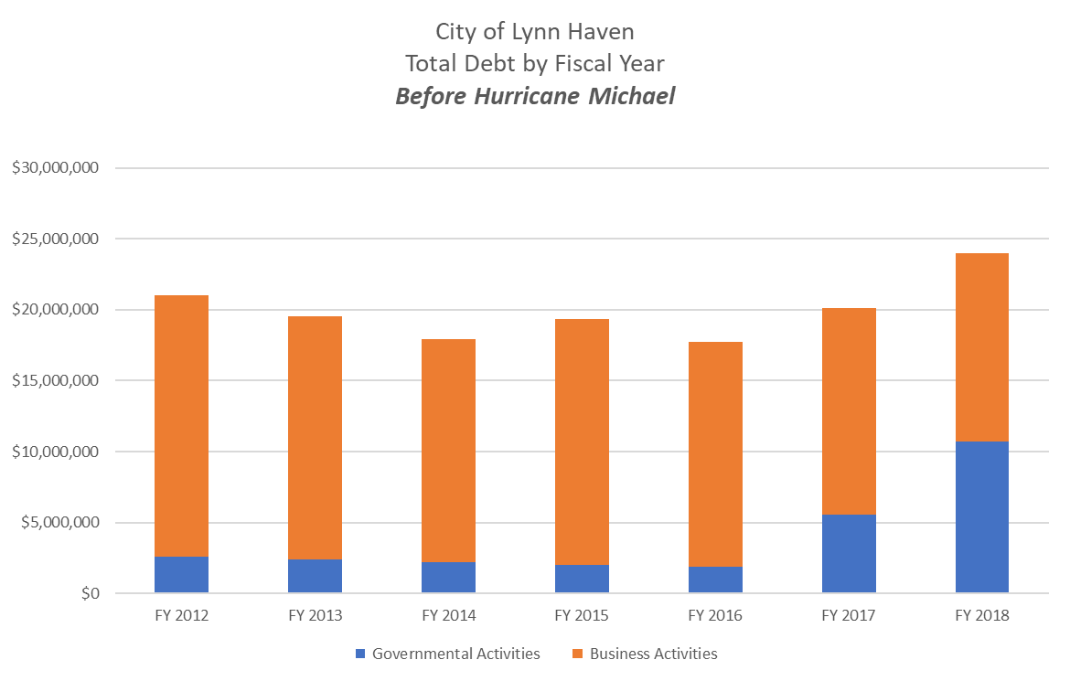
Current and Historic Debt Review Before Hurricane Michael

Slide 7

Current and Historic Debt Review
Debt Service Analysis
Total Principal balance at the end of each Fiscal Year
Per Audited Financial Statements
 | Governmental Activities | Business Activities |  | Grand Total |  | Source Document
FY 2012 | 2,554,800.00 | 18,455,200.00 |  | $ 21,010,000.00 |  | FY 2013 Audit Page #9
FY 2013 | 2,388,210.00 | 17,151,789.00 |  | $ 19,539,999.00 |  | FY 2013 Audit Page #9
FY 2014 | 2,210,230.00 | 15,749,593.00 |  | $ 17,959,823.00 |  | FY 2014 Audit Page #10
FY 2015 | 2,022,990.00 | 17,326,651.00 |  | $ 19,349,641.00 |  | FY 2015 Audit Page #10
FY 2016 | 1,859,180.00 | 15,885,550.00 |  | $ 17,744,730.00 |  | FY 2016 Audit Page #10
FY 2017 | 5,551,380.00 | 14,589,755.00 |  | $ 20,141,135.00 |  | FY 2017 Audit Page #10
FY 2018 | 10,741,710.00 | 13,221,124.00 |  | $ 23,962,834.00 |  | FY 2018 Audit Page #10
FY 2019 | 41,418,780.00 | 22,254,259.00 |  | $ 63,673,039.00 |  | FY 2019 Audit Page #12
FY 2020 | 44,227,242.00 | 24,659,467.00 |  | $ 68,886,709.00 |  | FY 2020 Audit Page #12

Slide 8
Debt Balance Per Year
*Does not include the CDL

Slide 9
Debt Balance Per Year (cont'd)
Debt Service Analysis
Total Principal balance at the end of each Fiscal Year
By Fund
 | General Fund | Disaster Recovery | Surtax | Water | Sewer | Stormwater |  | Grand Total
FY 2021 | 1,022,400.00 | 29,885,000.00 | 5,175,319.23 | 6,327,468.84 | 12,597,180.43 | 4,736,748.27 |  | $ 59,744,116.77
FY 2022 | 883,950.00 | 27,900,000.00 | 4,099,319.23 | 5,862,582.04 | 11,810,072.03 | 4,603,734.34 |  | $ 55,159,657.64
FY 2023 | 743,370.00 | 25,860,000.00 | 2,998,319.23 | 5,462,002.52 | 11,010,245.27 | 4,467,288.64 |  | $ 50,541,225.66
FY 2024 | 598,530.00 | 23,775,000.00 | 1,871,319.23 | 5,050,686.55 | 10,190,362.07 | 4,327,322.62 |  | $ 45,813,220.47
FY 2025 | 453,690.00 | 21,650,000.00 | 717,319.23 | 4,632,224.29 | 9,357,517.05 | 4,183,745.43 |  | $ 40,994,496.00
FY 2026 | 306,720.00 | 19,480,000.00 | 227,000.00 | 4,206,028.53 | 8,509,371.61 | 4,036,463.94 |  | $ 36,765,584.08
FY 2027 | 155,490.00 | 17,260,000.00 | - | 3,769,011.70 | 7,641,086.89 | 3,885,382.57 |  | $ 32,710,971.16
FY 2028 | - | 14,985,000.00 |  | 3,323,644.84 | 5,480,134.77 | 3,730,403.28 |  | $ 27,519,182.89
FY 2029 |  | 12,655,000.00 |  | 2,911,823.61 | 6,024,811.85 | 3,571,425.50 |  | $ 25,163,060.96
FY 2030 |  | 10,260,000.00 |  | 2,490,211.29 | 5,273,886.49 | 3,408,346.06 |  | $ 21,432,443.84
FY 2031 |  | 7,800,000.00 |  | 2,056,277.77 | 4,504,829.75 | 3,241,059.16 |  | $ 17,602,166.68
FY 2032 |  | 5,275,000.00 |  | 1,609,992.54 | 3,717,612.45 | 3,069,456.23 |  | $ 13,672,061.22
FY 2033 |  | 2,675,000.00 |  | 1,153,824.71 | 2,909,705.13 | 2,893,425.91 |  | $ 9,631,955.75
FY 2034 |  | - |  | 967,742.94 | 2,366,078.05 | 2,712,853.99 |  | $ 6,046,674.98
FY 2035 |  |  |  | 779,215.52 | 1,809,201.21 | 2,527,623.30 |  | $ 5,116,040.03
FY 2036 |  |  |  | 588,210.30 | 1,454,044.29 | 2,337,613.61 |  | $ 4,379,868.20
FY 2037 |  |  |  | 394,694.72 | 1,095,576.73 | 2,142,701.64 |  | $ 3,632,973.09
FY 2038 |  |  |  | 198,635.78 | 733,767.69 | 1,942,760.91 |  | $ 2,875,164.38
FY 2039 |  |  |  | (0.00) | 368,585.99 | 1,737,661.70 |  | $ 2,106,247.69
FY 2040 |  |  |  |  | 0.00 | 1,527,270.88 |  | $ 1,527,270.88
FY 2041 |  |  |  |  |  | 1,311,451.95 |  | $ 1,311,451.95
FY 2042 |  |  |  |  |  | 1,090,064.87 |  | $ 1,090,064.87
FY 2043 |  |  |  |  |  | 862,965.94 |  | $ 862,965.94
FY 2044 |  |  |  |  |  | 630,007.83 |  | $ 630,007.83
FY 2045 |  |  |  |  |  | 391,039.37 |  | $ 391,039.37
FY 2046 |  |  |  |  |  | 145,905.47 |  | $ 145,905.47
FY 2047 |  |  |  |  |  | - |  | $ -

Slide 10
Estimated City Rebuild Cash Flow thru September 1, 2025
2019 Disaster Recovery Bond
Cash Flow Estimates as of 7-15-2021
Presented to the Debt Review Committee
City Rebuild Current Budget:
LOCATION | COMMENTS | BUDGETED COST
New City Hall/Chambers/PD(428) | Design, Bid, Build | 13,863,184.00
Sales Tax Cost Savings and Value Engineering |  | (750,000.00)
Old City Hall (included in the # above) | Design, Bid, Build | -
Library(insurance deduction) | Design, Bid, Build | 1,100,000.00
Senior Center/Garden Club | Internal Remodel | -
Public Works | Design, Bid, Build | 400,000.00
Facilities Maintenance | Design, Bid, Build | 525,000.00
Fire Department #1 | Design, Bid, Build | 450,000.00
Sports Complex Building (428) | Design, Bid, Build | 6,940,000.00
Sales Tax Cost Savings |  | (500,000.00)
Sports Complex Ballfields/City Park (428) | Multi-Million, TBF | 6,996,776.00
Sales Tax Cost Savings |  | (500,000.00)
Animal Shelter Bldg. | Internal Remodel | -
Grand Total Rebuild Cost |  | $ 28,524,960.00
Estimated Cash Balance at 8-30-21 |  | $ 24,862,967

Slide 11
Estimated City Rebuild Cash Flow thru September 1, 2025 (cont'd)
ESTIMATES of In Flows and Out Flows
Projected FEMA Reimbursement |  | $ 24,424,203
Projected Insurance Settlement |  | $ 6,000,000
Total Estimated In Flow (7-9-21 through 9-1-25) |  | $ 30,424,203
Total Estimated Rebuild |  | $ 28,524,960
Less progress payments made to date as of 8-15-21 |  | $ (3,042,581)
Projected Debt Service (Principal & Interest) |  | $ 13,371,652
Total Estimated Out Flow (7-9-21 through 9-1-25) |  | $ 38,854,031
Estimated Cash Balance at 9-1-25 |  | $ 16,433,139
Balance of 2019 Disaster Recovery Bond at 9-1-25 |  | $ 21,650,000
Unfunded Principal Portion of 2019 Disaster Recovery Bond as of 9-1-25 |  | $ 5,216,861

Slide 12
Debt Forgiveness: Community Disaster Loan
To qualify for a CDL the local government must:
Be located in the presidentially declared disaster area, and the disaster must have adversely affected the level of essential municipal services previously provided.
Be able to show a substantial loss (greater than 5%) of tax and other revenues for the current or succeeding year as a result of a major disaster.
Not be in arrears with respect to any payments due on previous loans.
The City was granted the $5 million. Forgiveness of the loan will be assessed in 2022.

Slide 13
Committee Recommendations: The Four Rs
Re-evaluate
Refinance
Restore
Recoup potential funds after litigation

Slide 14
QUESTIONS?

